Slide 1
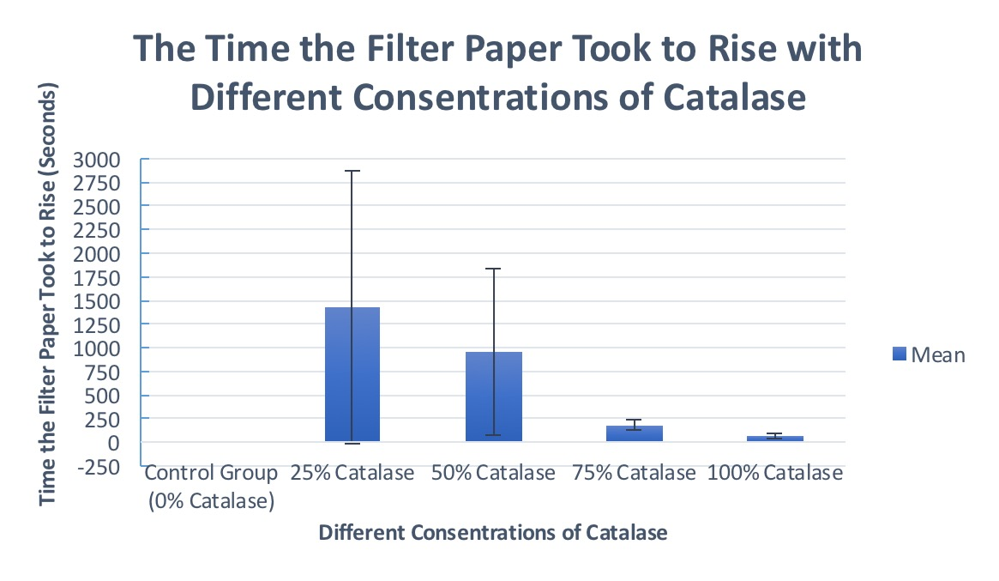
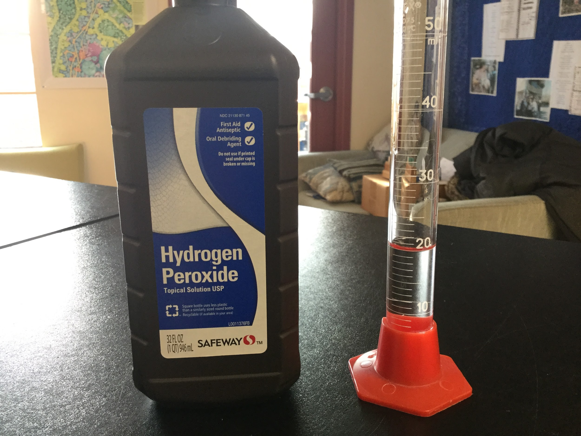
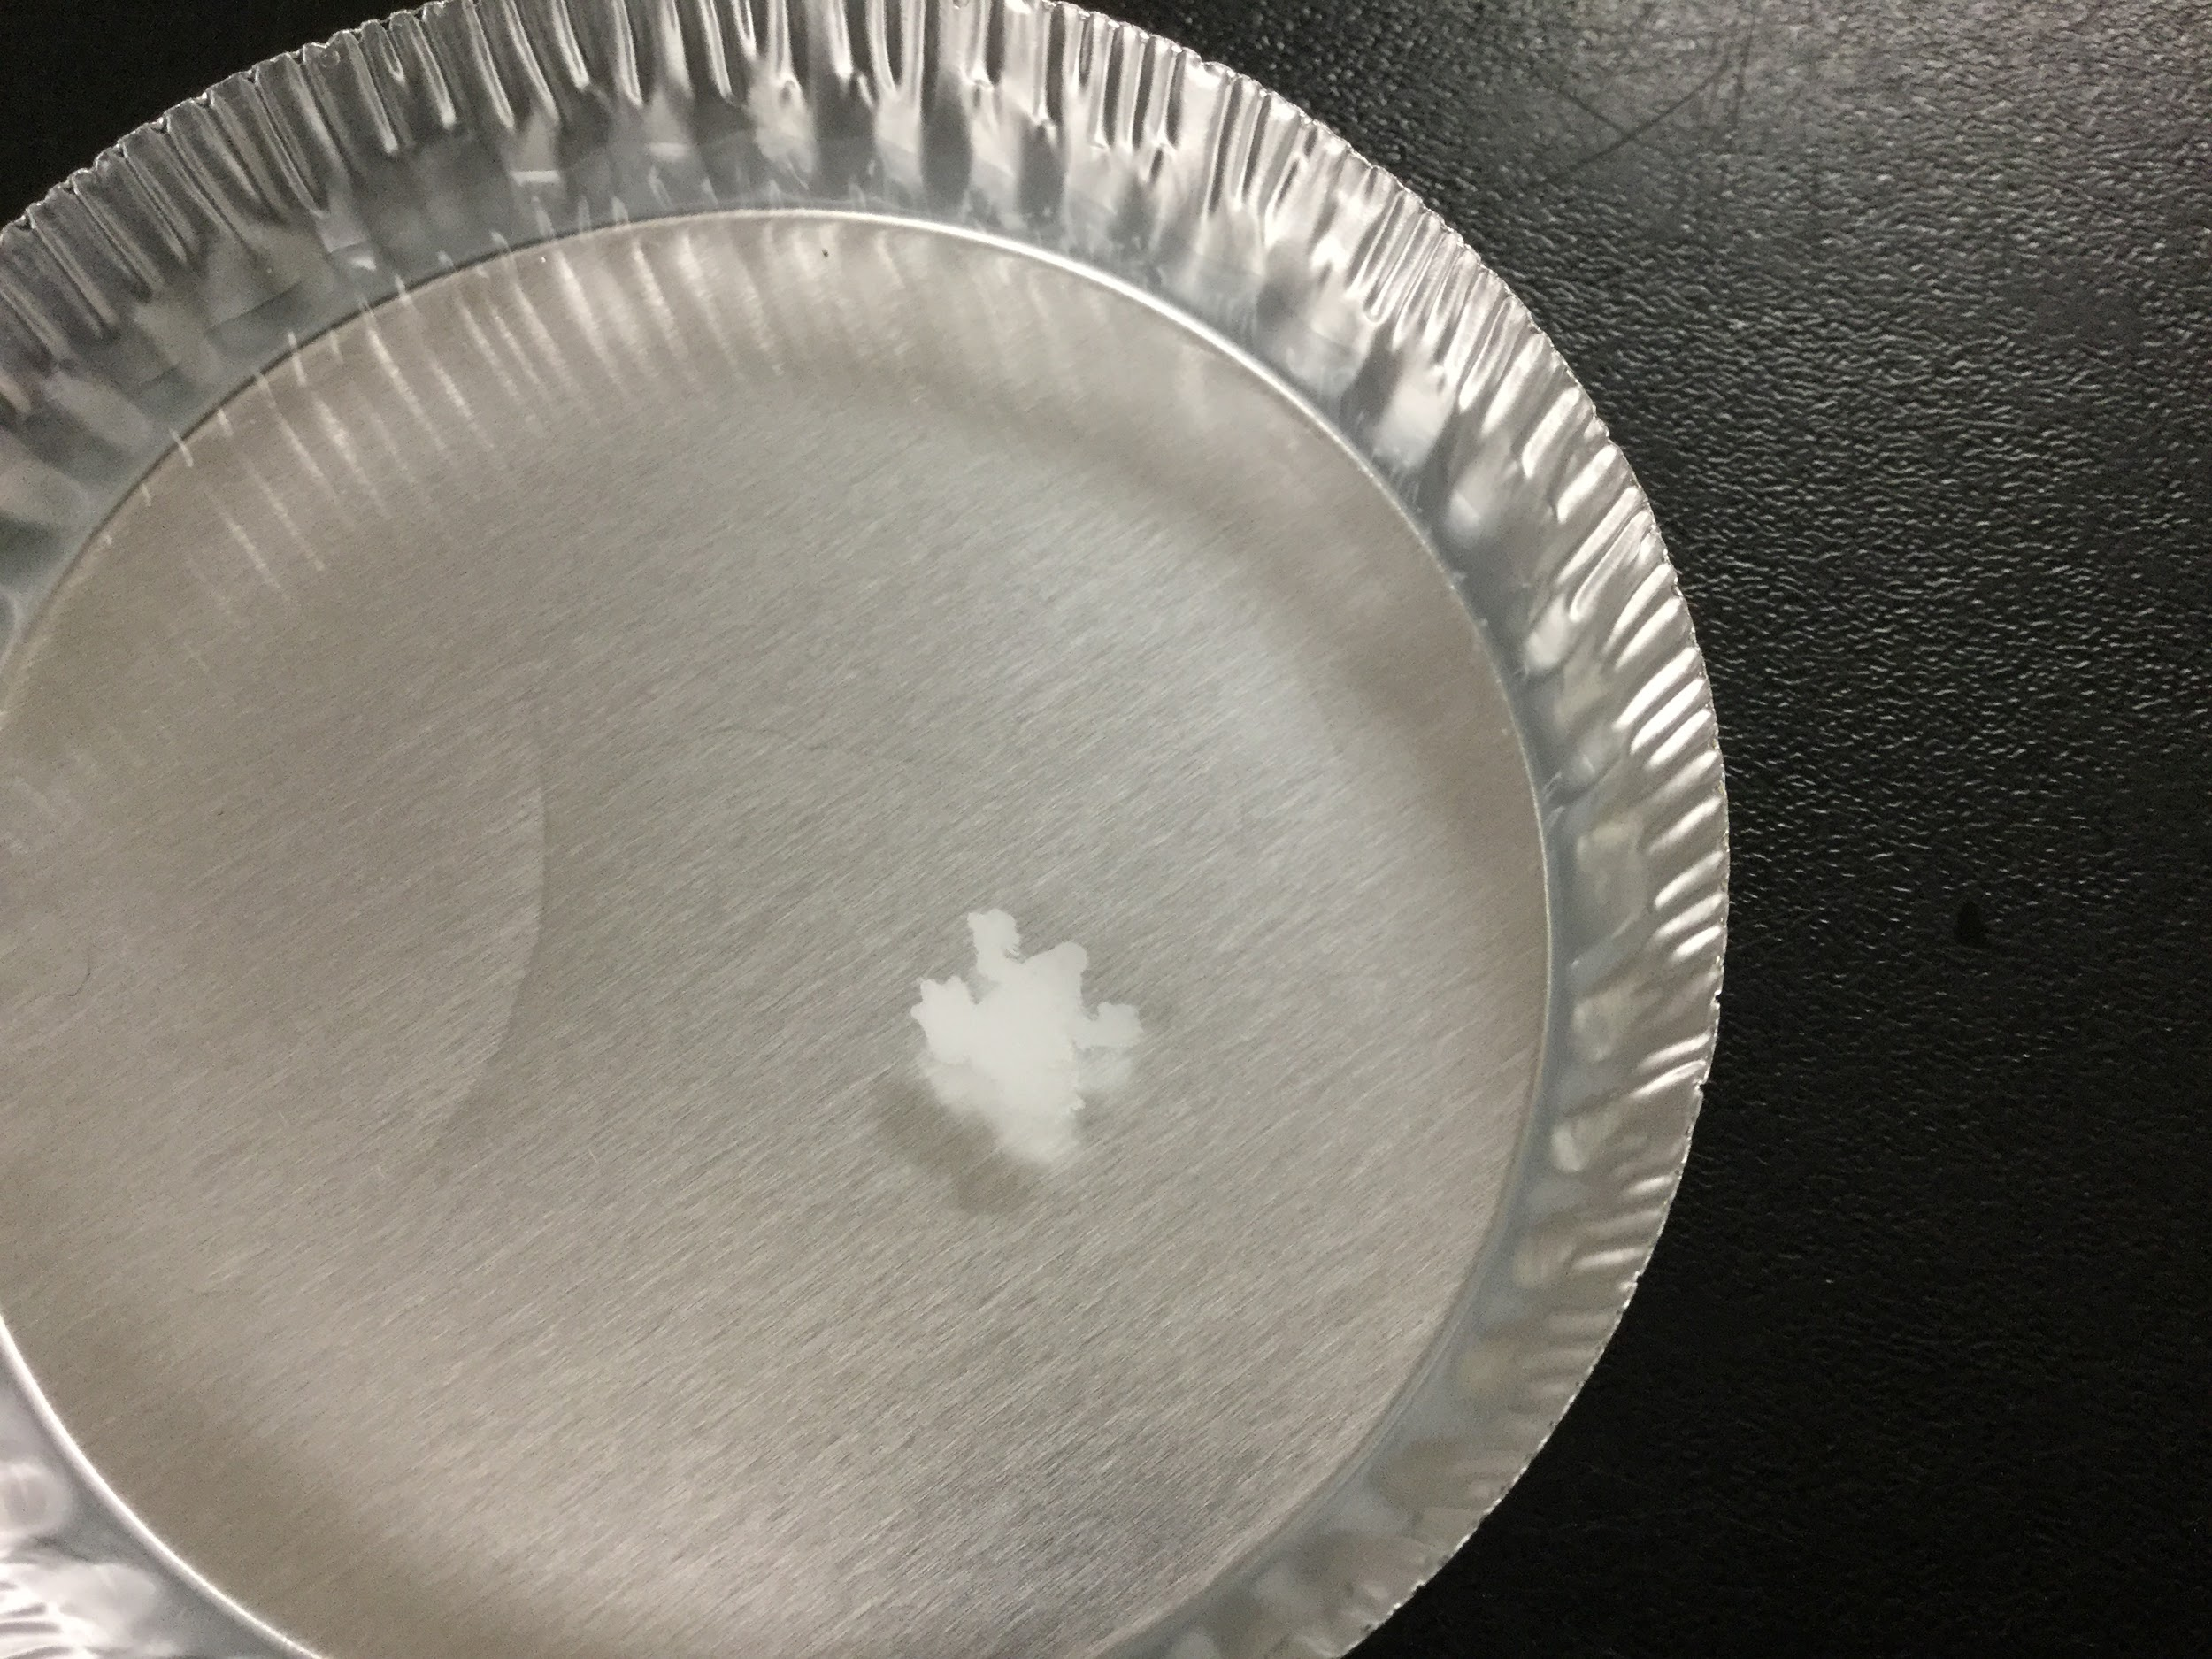
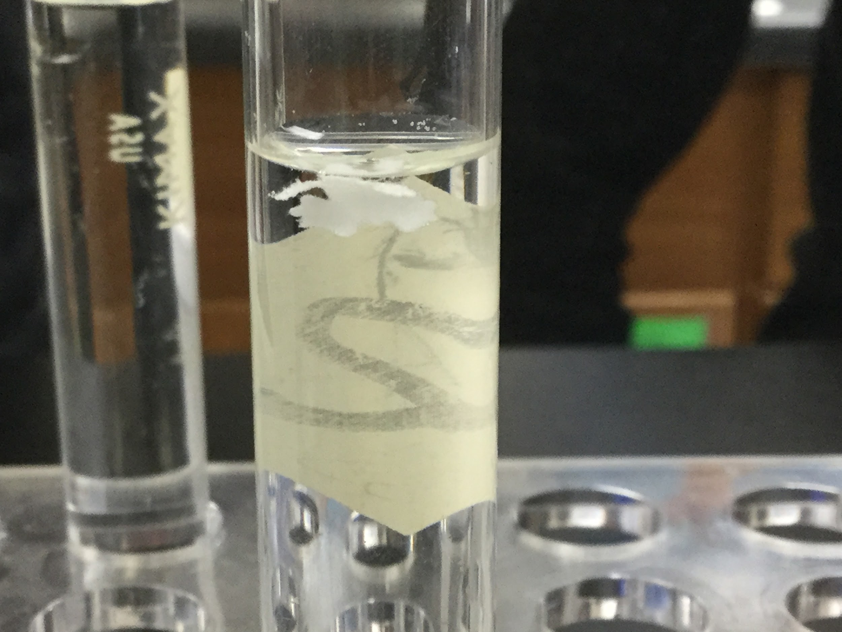
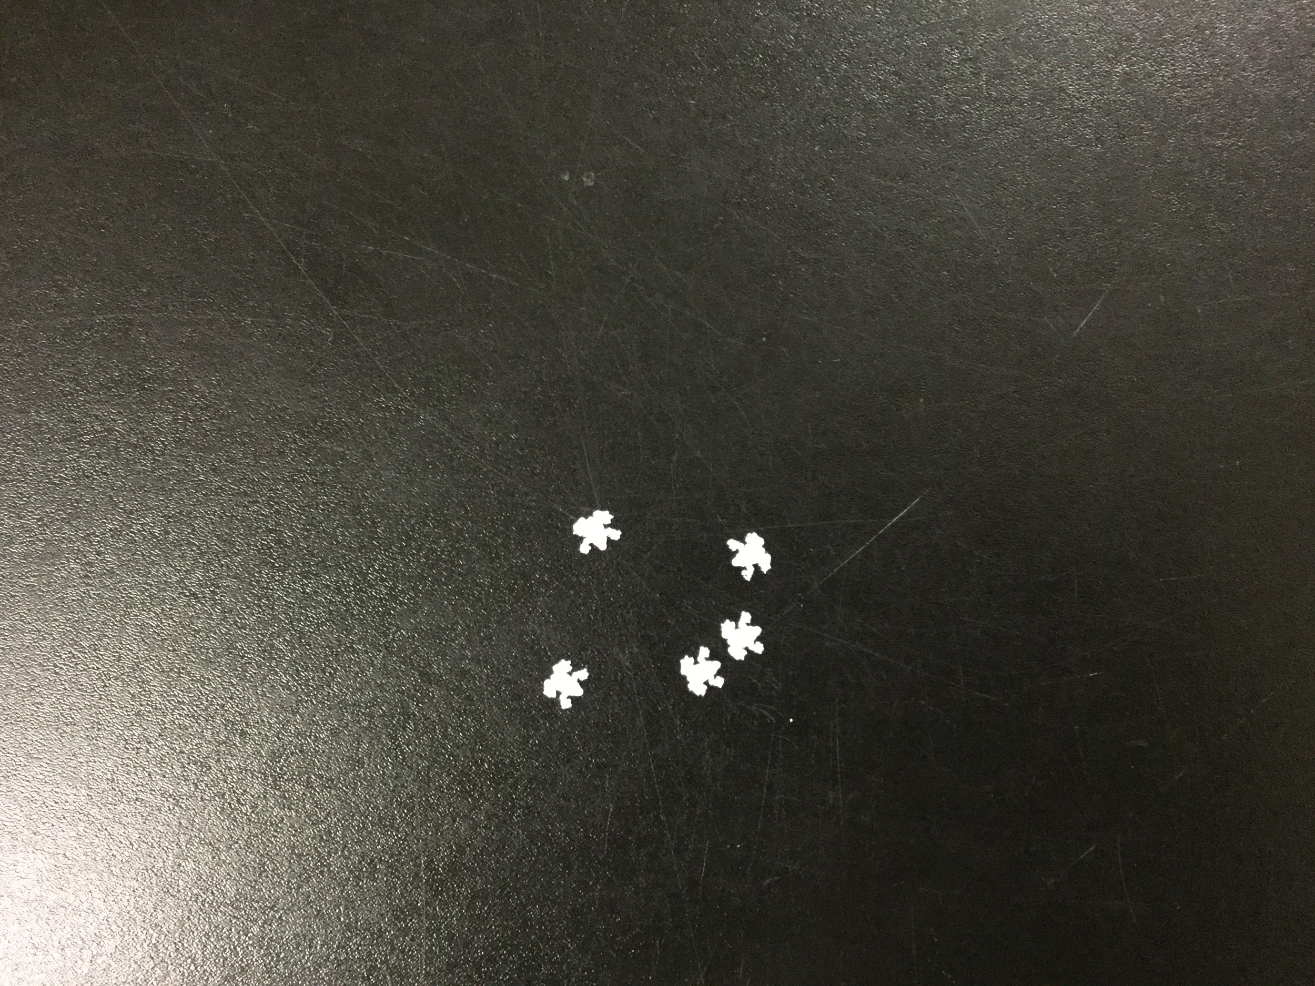
The Impact of Catalase Concentration on the Catabolism of Hydrogen Peroxide Into Water
Alan Burd, Seth Gorton, Muhammad Jallow, Kevin Ye
Sandy Spring Friends School, Sandy Spring, MD
Introduction
Methods
Conclusions
Background Info: Catalase from animal can increase the speed of catabolism of Hydrogen Peroxide.
- We acquired filter paper for all five test tubes which were immersed in trays containing the catalyst, which in this experiment was chicken liver. Each of us picked a test tube and put filter papers into it according to the percentage of catalase the filter paper was dipped into.
- Lastly we recorded the amount of time it took for the filter paper to surface as soon as it touched the bottom of the test tube. Our results are in the next section in the form of a Clustered Column Graph.
- We accepted our alternative hypothesis that states: the more concentration of catalase, the faster the reaction rate is.
- The catalase from the chicken liver was mixed with water through a given ratio and then a filter paper was placed in the solution.
- The chemical reaction of the catalyst and hydrogen peroxide cause catabolism and particles in the hydrogen peroxide started to bubble.
- We started our timers when the filter paper reached the bottom and we found that filter papers that were soaked in a more concentrated solution of catalase had quicker reaction times
Research Objective: The research objective of our experiment is to discover how the concentration of the catalase affects the rate of reaction.
Hypothesis (Alternative): The more concentrated the catalyst, the faster the reaction rate will be.
Enzyme: Enzymes are proteins that catalyze, or speed up the rate of a reaction.
Substrate
Future Directions
Enzyme
- In the future, clean test tubes more thoroughly.
- In the future, make sure to keep exact same ratio of catalase to water in chicken liver solution.
- In the future, mix water and catalase more precisely and don't just dump contents into petri dish.
Results
Here we have a clustered column graph showing us the average time, in seconds, that it took for the filter paper to rise after it touched the bottom of the test tube.
Methods
Acknowledgements
A big thank you to Takisha Reece for providing all the materials and components needed for the experiment such as the test tubes and the chicken liver. Another thank you to Takisha Reece for staying in the science room and waiting for the filter paper to rise while I went to lunch (it took 51 minutes to rise). A final thank you to the Sandy Spring Friends School Science Department for making this experiment possible.
- To start our experiment, we gathered the above pictures, which are; 20 milliliters of Hydrogen Peroxide (which has the chemical formula of H₂O₂), five test tubes, one filled with 0% catalase, and the rest containing 25% catalase, 50% catalase, 75% catalase and 100% catalase (all using H₂O₂).
Notes:
Ohgaye

