Slide 1
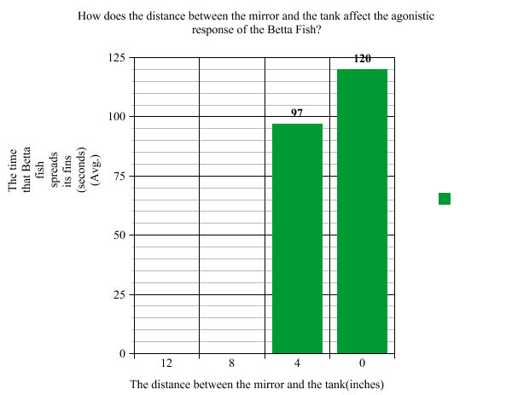
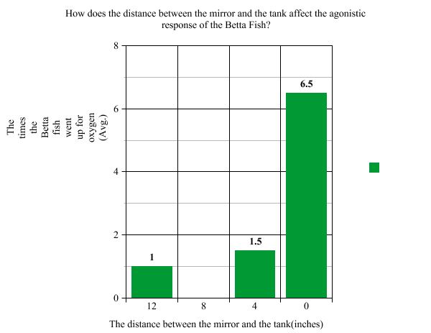
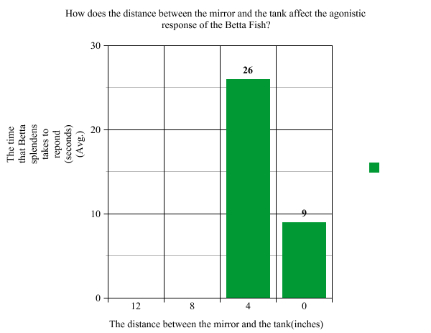
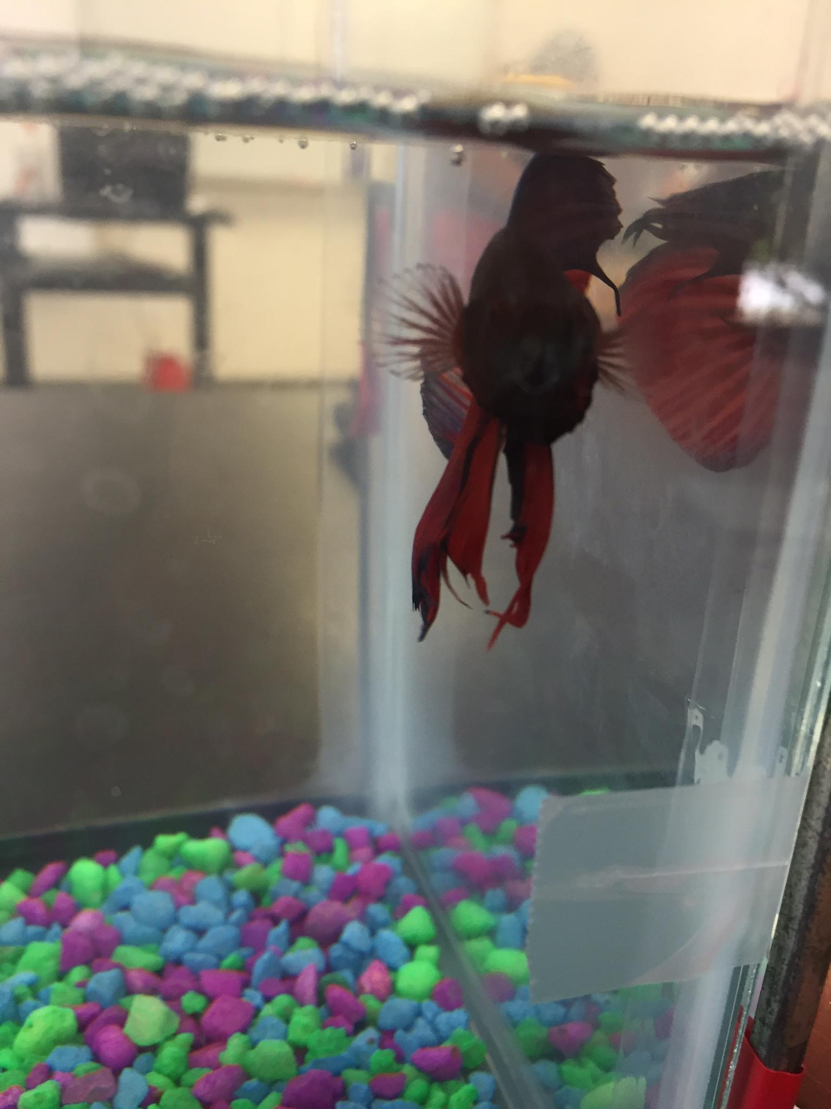
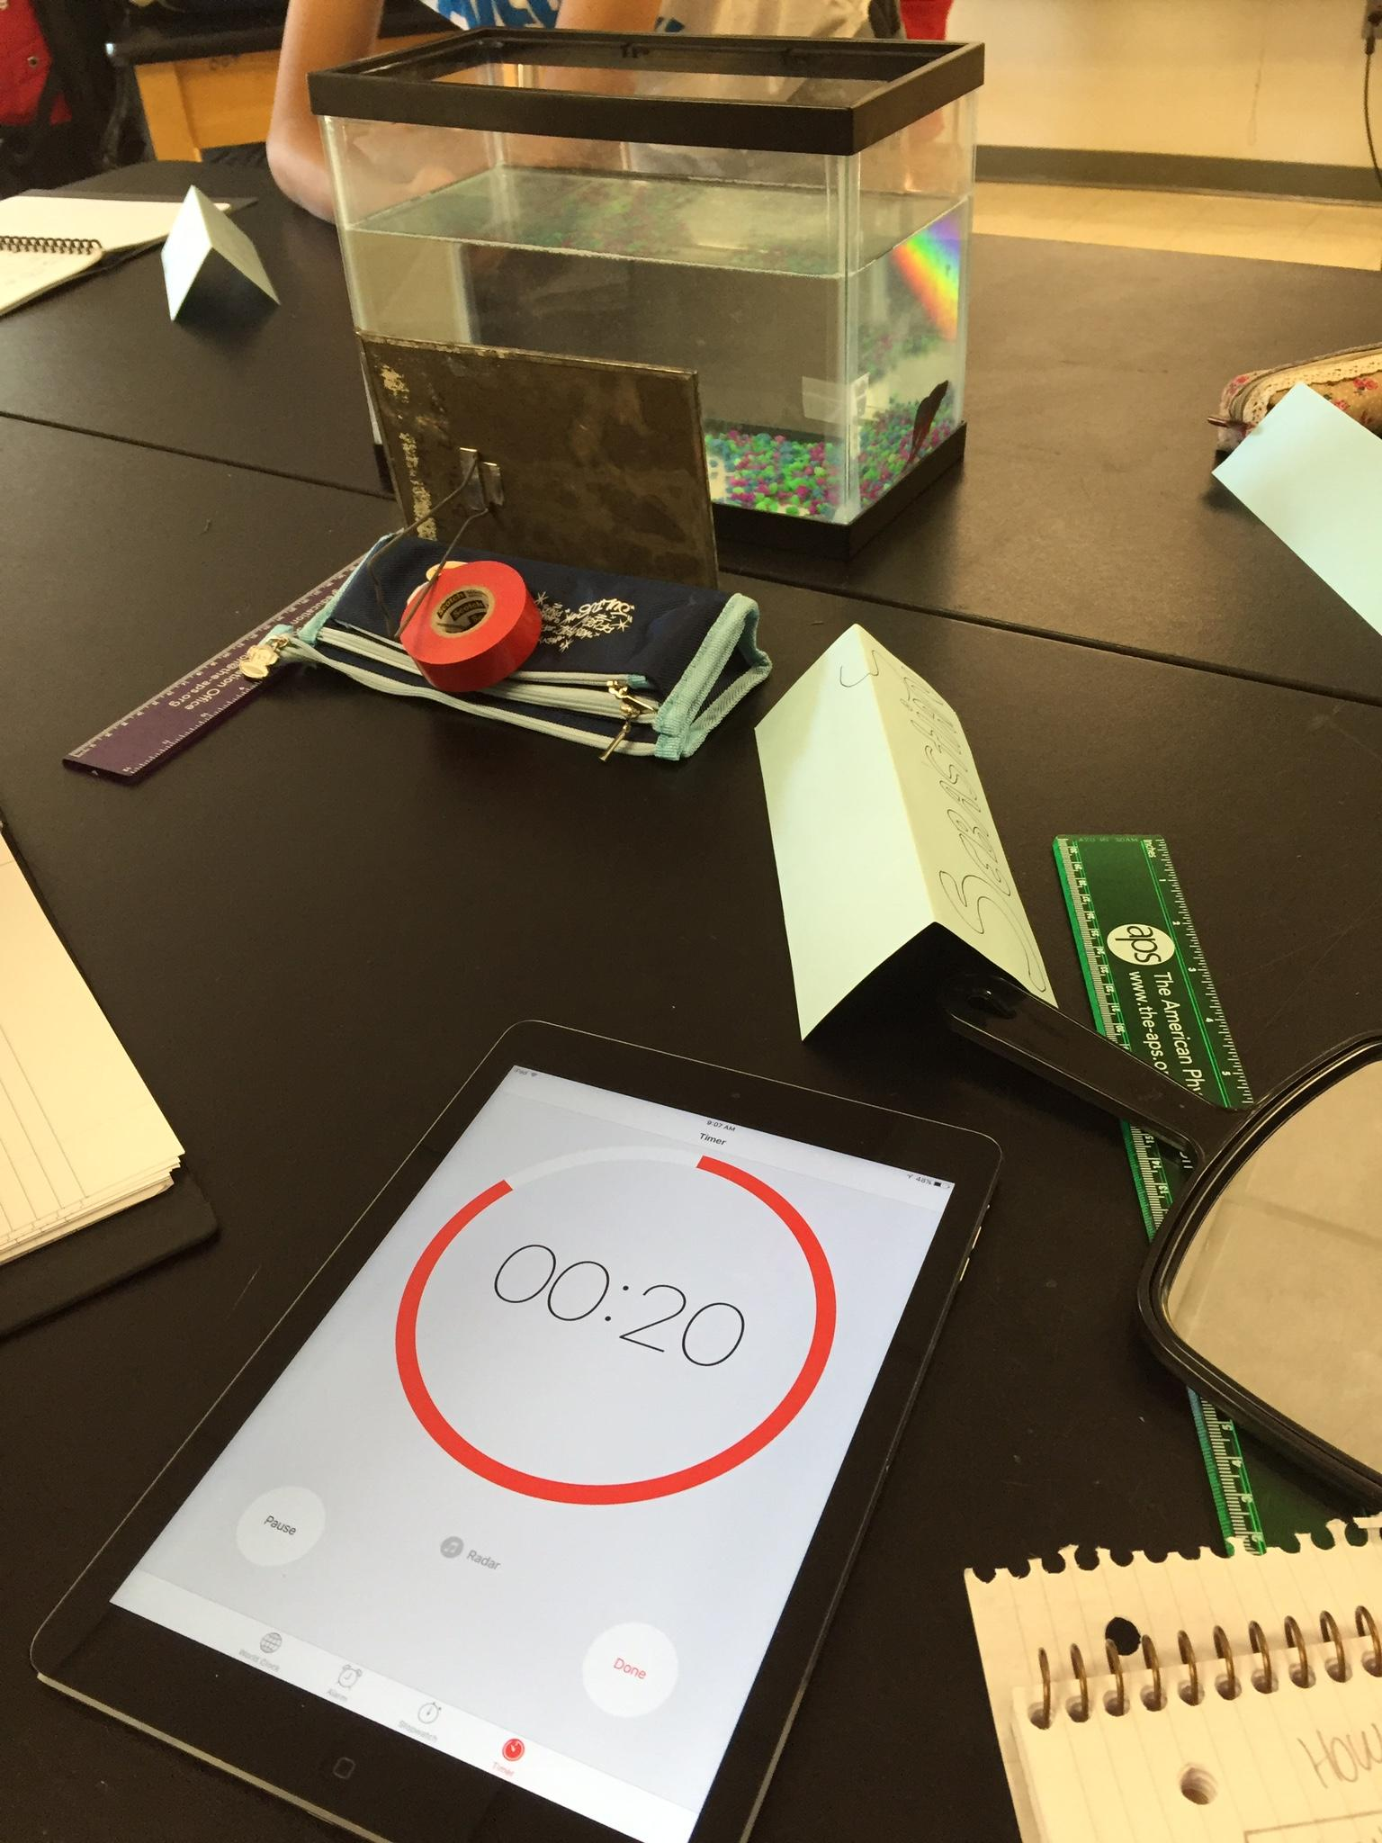
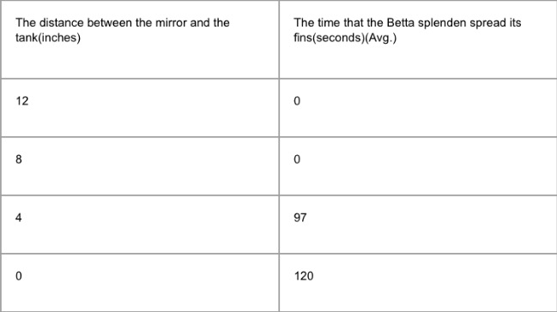
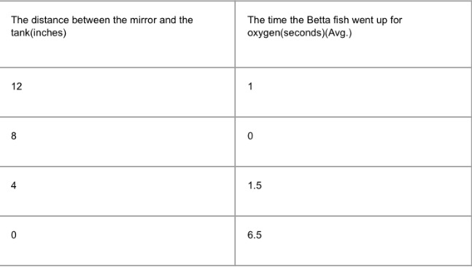
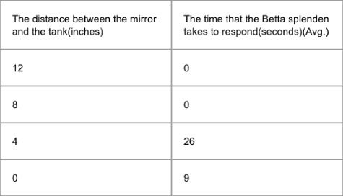
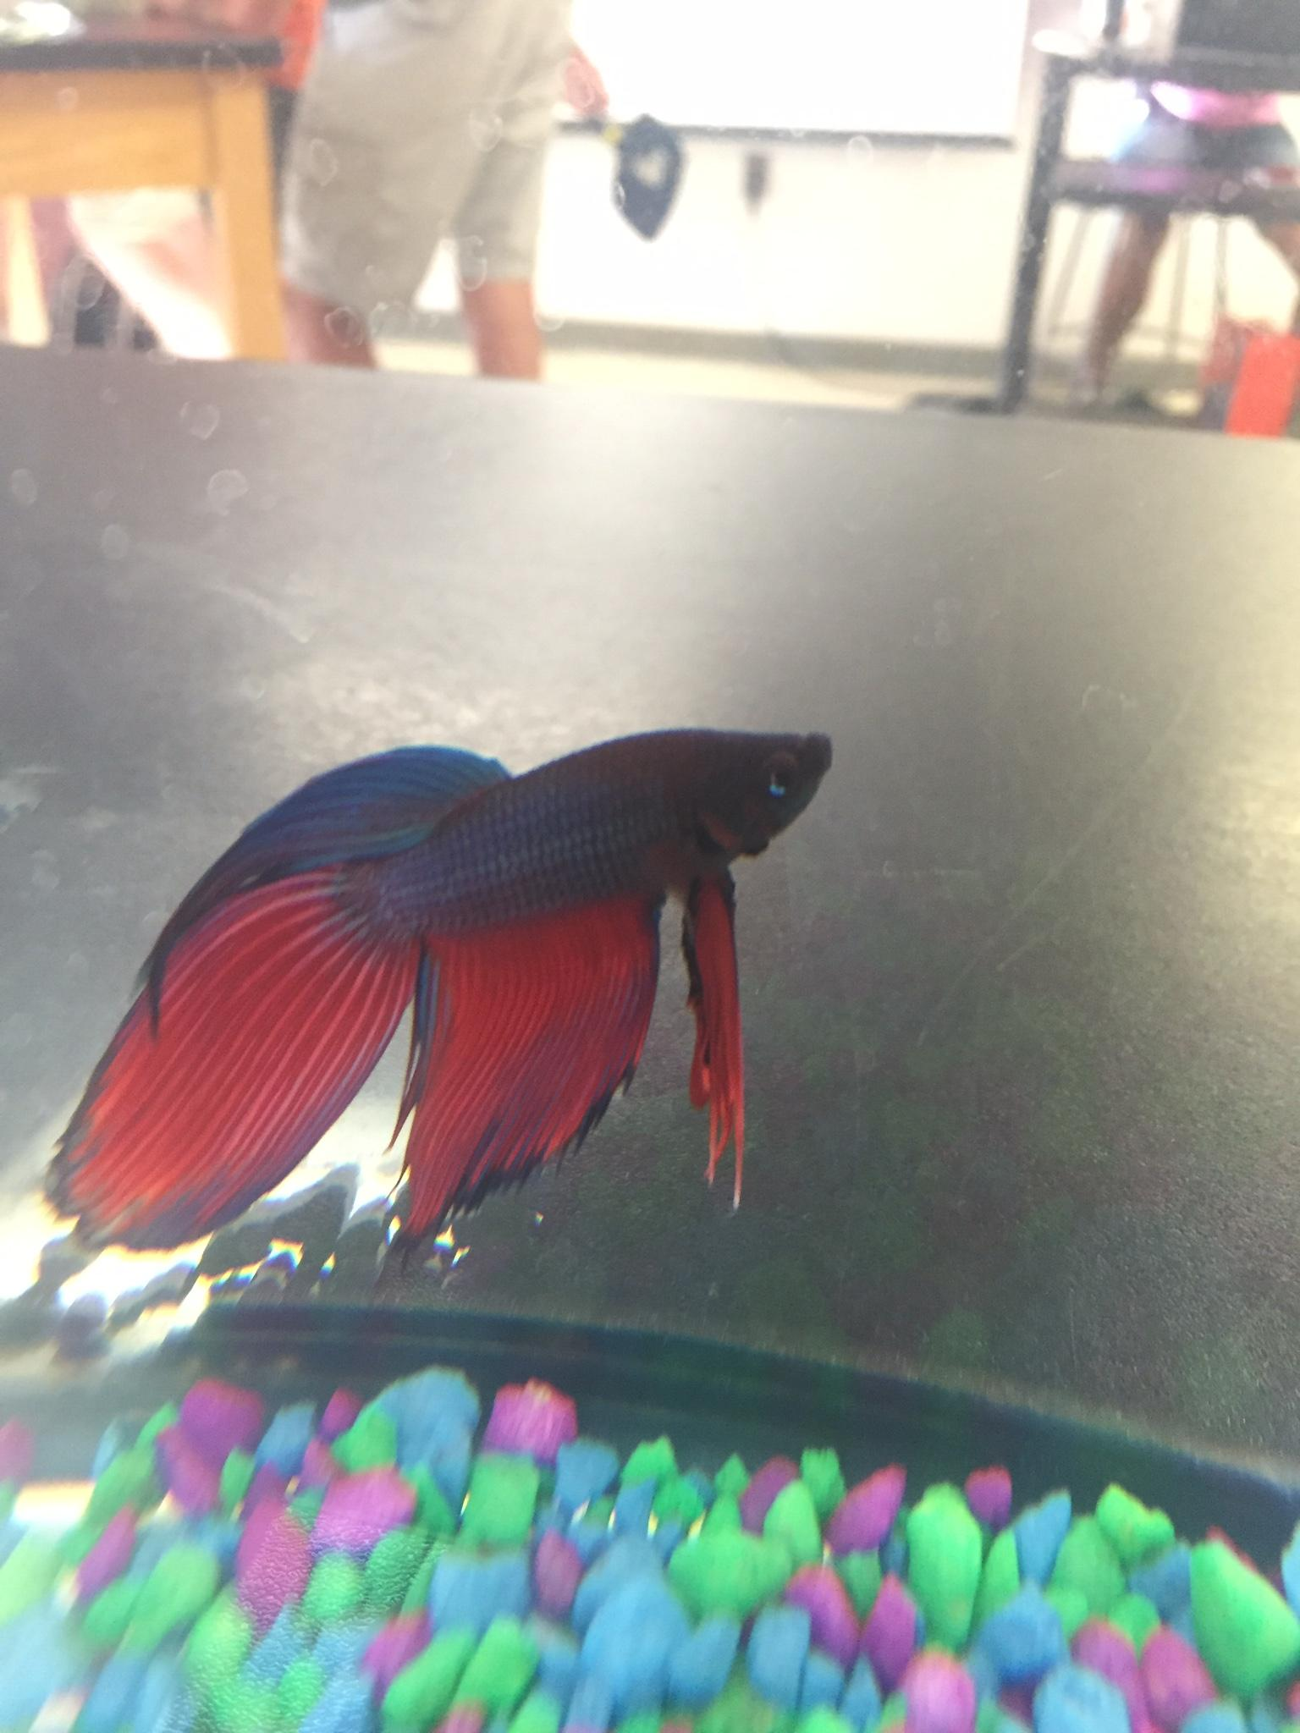
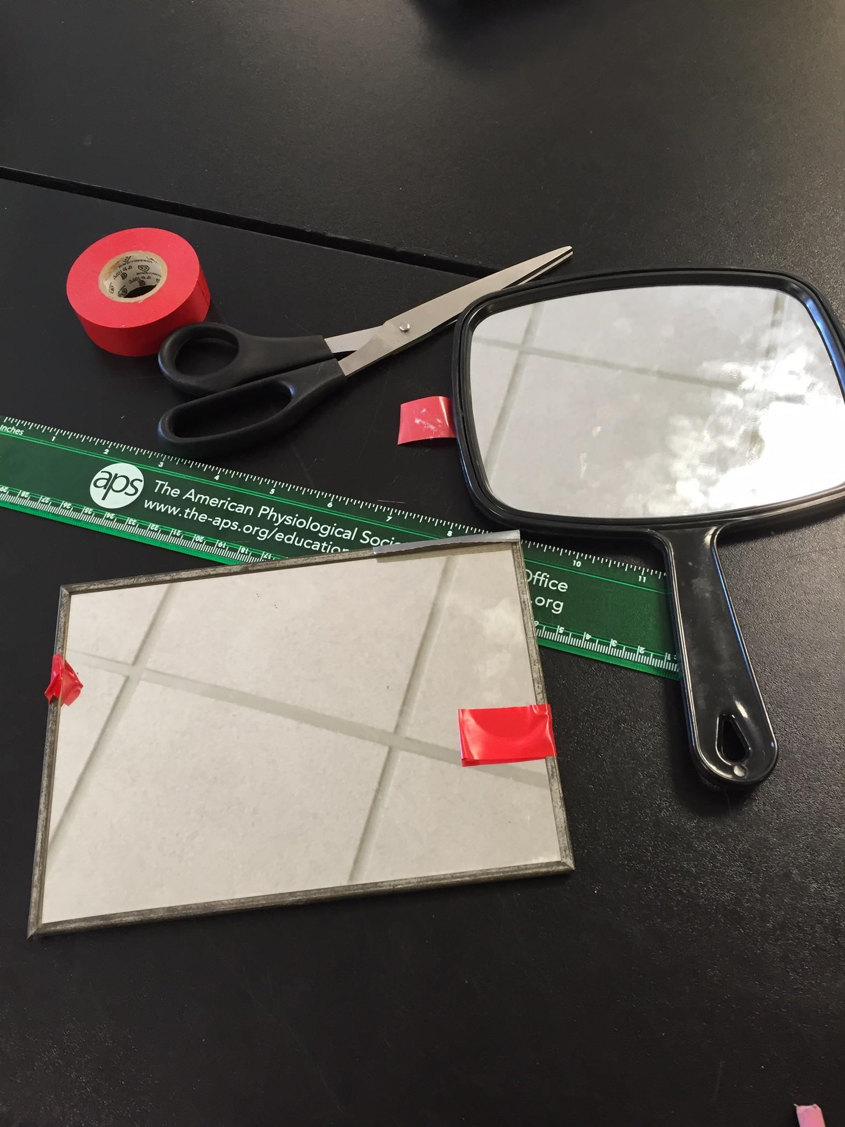
Background info.
The distance of the mirror affects the agonistic response of the Betta fish
Sandy Spring Friends School, Sandy Spring, MD 20860
Sebastian Goodman, Lia Hill, Muhammad Jallow, Kevin Ye, Jonathan Lin
Conclusion
In the biology class, we noticed that a male Betta splendens spread all his fins out when a mirror was set on the tank. We are trying to figure out how the mirror effects the Betta splendens.
-Overall this experiment was successful.
- The closer the mirrors was to to the tank the more of an agonistic response from the Betta was shown.
Results
Question
Term
How does the distance between the mirror and the tank influence the agonistic response of the Betta splendens?
Agonistic response: a certain kind of response when facing some certain situation, the creature becomes aggressive..
Hypothesis
The closer the reflection is to the Betta fish's tank, the more we notice it's agonistic response.
Future Directions
Objective
Typed or have done our data tables in computer instead of paper.
Try to prove if the same conclusion applies to other kind of fish
To investigate the impact of the distance between mirror and tank on the agonistic response of Betta fish.
Methods
-With a ruler measure the distance (12, 8, 4, and 0 inches) of the mirror from the tank.
-Put the mirror from 12 inches long, then observe the response of the Betta splendens for 2 minutes. Collect the data into data tables.
-Let the fish rest for 1 minute.
-Set the mirror from 8 inches long. Investigate the fish for 2 minutes. Add numbers into data table.
-Let fish rest for 1 minute.
-Set the mirror from 4 inches, then repeat the second and fourth step (Observe the fish).
-Rest.
-Use tape to put the mirror on the wall of the tank(0 inches). Then observe and collect data.
-Use the data and then draw the conclusion.
Materials
Acknowledgements
We would like to thank Teek for supplying us with the materials we needed, adding comments to guide our poster and completely overseeing our project.
A male Betta splenden,
Two mirrors, a ruler, tape

